Slide 1

Pattern recognition
Fall 2023
Seraina Kytili 9728

Slide 2
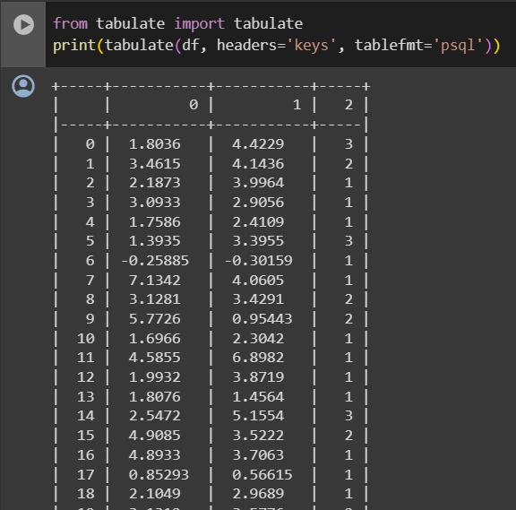
Data Overview
The dataset is loaded from dataset.csv file.
The samples are 280.
Each sample has a 2D vector along with a label (1, 2, or 3).
This dataset will be used in parts A, B and C.

Slide 3
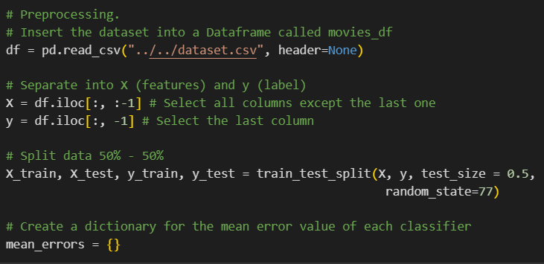
Imports and preprocessing
Import the libraries needed.
Load the dataset.
Separate features and labels.
Split train and test datasets.

Slide 4
A. Bayesian Classifier with Maximum Likelihood Estimation
The goal is to implement a Bayesian classifier using Maximum Likelihood Estimation and compare different covariance table approaches.
We'll compare the performance of the classifier when assuming the same covariance matrix for all classes versus different covariance matrices for each class.

Slide 5
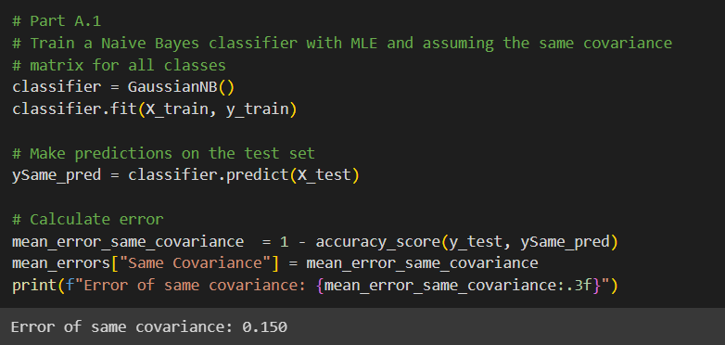
A.1 - classifier with same covariance
Classifier Type: Gaussian Naive Bayes.
Assumption: Same covariance matrix for all classes.
Training: Fit the classifier with the training data.
Predictions: Use the trained classifier to make predictions on the test set.
Error Calculation: Calculate the mean error by comparing the predicted labels with the true labels. Utilize the accuracy score as the error metric.
Result Display: Print and store the mean error for the case of the same covariance matrix.

Slide 6
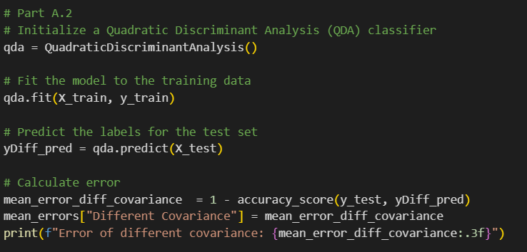
A.2 – classifier with different covariances
Classifier Type: Quadratic Discriminant Analysis (QDA)
Assumption: Different covariance matrix for all classes.
Training: Fit the classifier with the training data.
Predictions: Use the trained classifier to make predictions on the test set.
Error Calculation: Calculate the mean error by comparing the predicted labels with the true labels. Utilize the accuracy score as the error metric.
Result Display: Print and store the mean error for the case of the same covariance matrix.

Slide 7
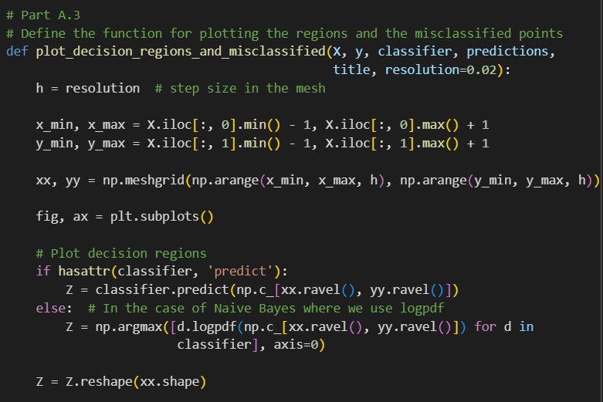
A.3 - Function
Function Purpose: Define a function to plot decision regions and mark misclassified points.
Input Parameters:
X: Feature matrix (2D),
y: True labels,
classifier: Trained classifier or distribution models,
predictions: Predictions made by the classifier,
title: Title for the plot,
resolution: Step size in the mesh for decision region plotting.
Meshgrid Creation: Generate a meshgrid based on feature ranges and the specified resolution.
Decision Regions Plotting: Use the classifier to predict classes for meshgrid points.

Slide 8
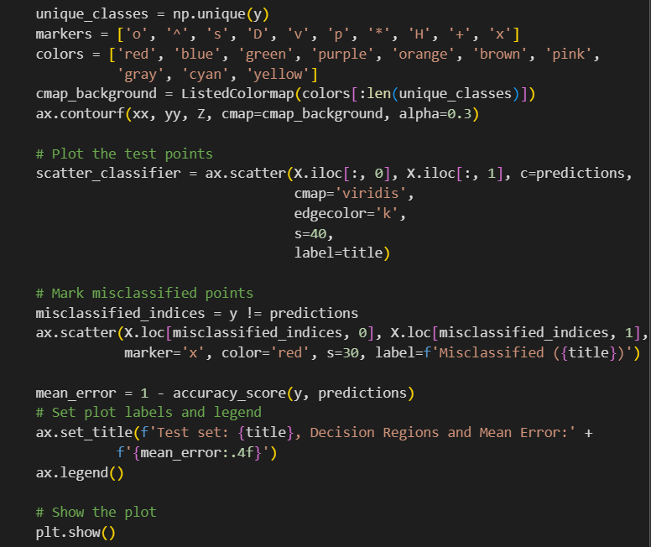
A.3 - Function
Background Plotting: Fill decision regions with distinct colors.
Scatter Plot: Display test points with predicted class colors.
Misclassified Points: Identify and mark misclassified points with a red 'x'.
Legend and Labels: Include a legend with the title and mean error information.
Mean Error Calculation: Calculate mean error by comparing true labels with predictions.
Plot Title: Set the plot title to include test set details, decision regions, and mean error.
Display Plot: Show the generated plot.

Slide 9
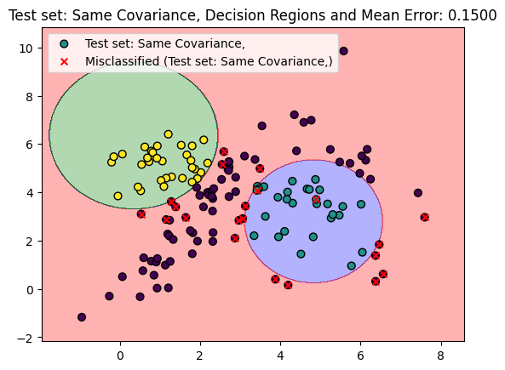

Slide 10
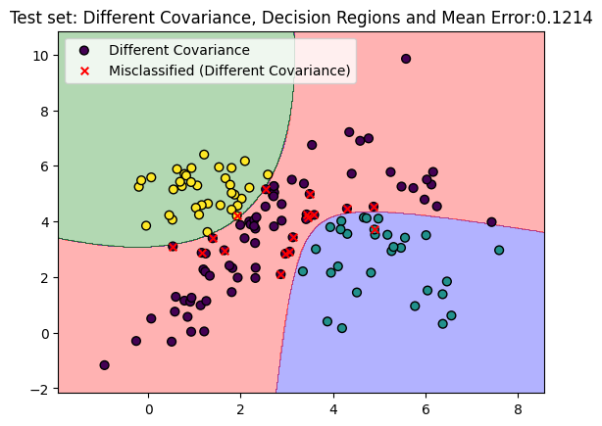

Slide 11
a.3 - results
The lower mean error in the model with different covariances suggests improved modeling of class-specific variations, indicating that this approach might be more suitable for the specific dataset. However, a comprehensive analysis, considering various metrics and potential trade-offs, will provide a more thorough understanding of model performance.
Same Cov | Different Cov
0.150 | 0.121

Slide 12
b. k-nn classifier
The goal is to provide insights into the behavior of the k-NN classifier under different parameterizations.
Emphasize the comparative aspect with the results from the previous part.

Slide 13
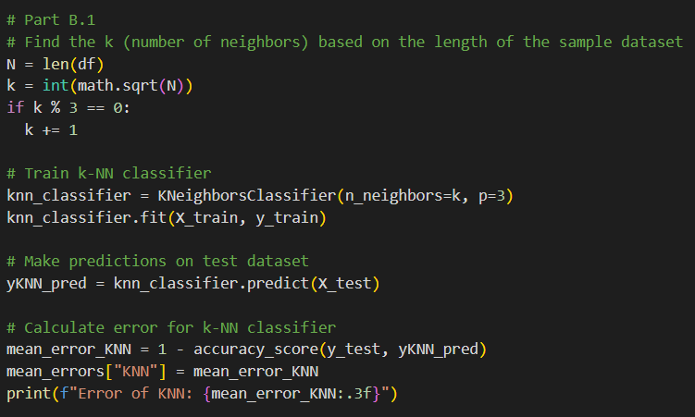
B.1 – create K-NN CLASSIFIER
Classifier Type: k-NN Classifier (Minkowski p=3)
Find the Optimal k:
Determine the number of neighbors (k) based on the square root of the length of the sample dataset.
If k is divisible by 3, increment it by 1 to ensure diversity.
Training: Fit the classifier with the training data.
Predictions: Use the trained classifier to make predictions on the test set.
Error Calculation: Calculate the mean error by comparing the predicted labels with the true labels. Utilize the accuracy score as the error metric.
Result Display: Print and store the mean error for the case of the same covariance matrix.

Slide 14
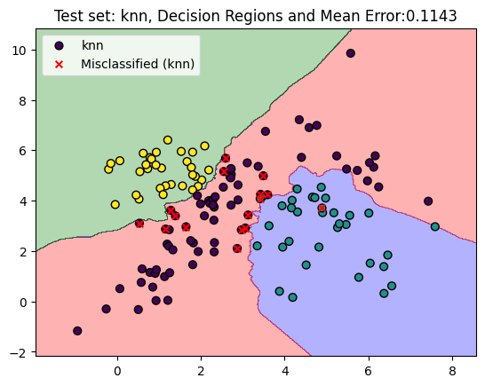
B.2 – plot the test dataset
The function explained in A.3 has been used to display the results.
It seems that knn is more accurate than all Bayesian Classifiers with Maximum Likelihood Estimation.

Slide 15
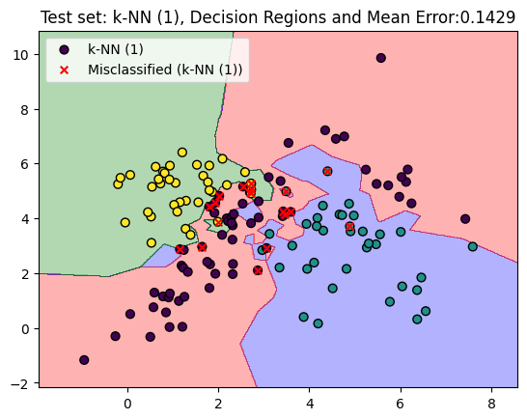
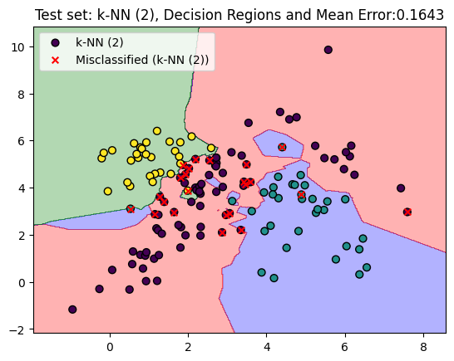
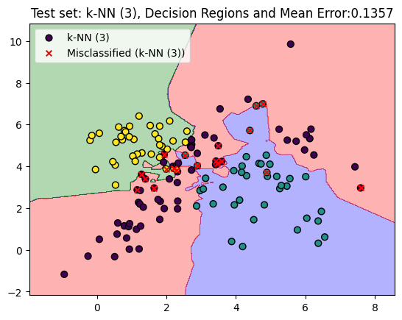
b.3 – plot classifiers with different # of neighbors

Slide 16
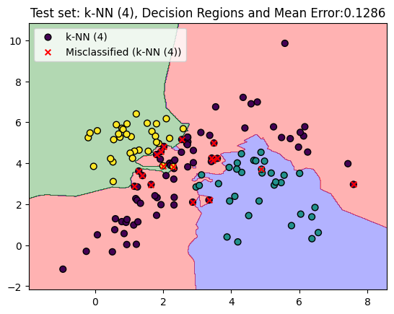
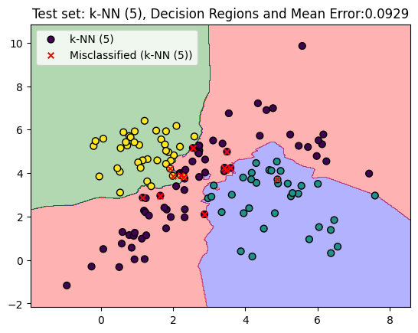


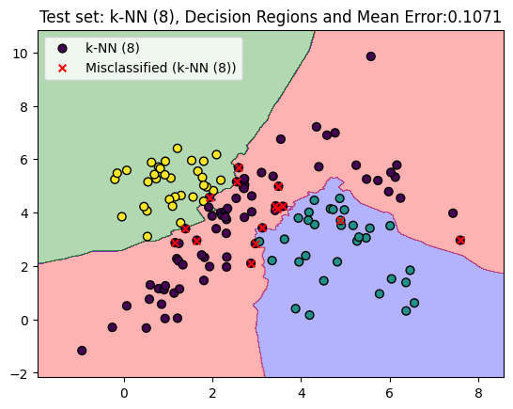
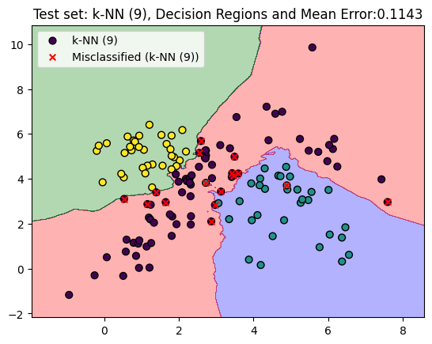

Slide 17
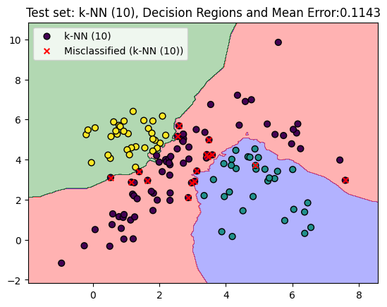
b.3 – plot classifiers with different # of neighbors
The increasing values of k in KNN demonstrate the classic bias-variance trade-off. Smaller values of k may lead to overfitting, while larger values may lead to oversmoothing.
The observed decrease in mean error suggests that a moderate value of k, such as 5, is providing a good balance between bias and variance in this particular case.
The KNN classifier with k=5 appears to outperform both Maximum Likelihood Bayes models in terms of mean error.

Slide 18
c. Svm classifiers
The goal is to gain a nuanced understanding of SVM classifiers, their performance with different kernels, and provide a visual representation of the dataset to aid interpretation.
Emphasize the comparative aspect with the results from the previous part.

Slide 19
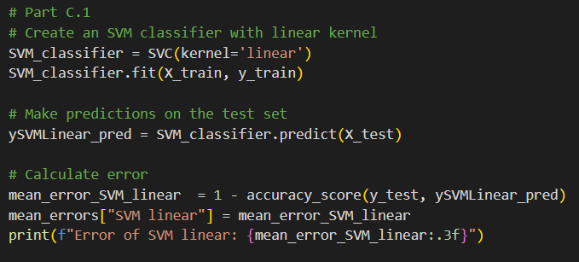
c.1 – linear svm
Classifier Type: Support Vector Machine (SVM) with Linear Kernel.
Kernel Choice: Linear kernel is employed for the SVM classifier.
Training: Train the SVM classifier using the training data (X_train, y_train).
Predictions: Utilize the trained SVM classifier to make predictions on the test set (X_test).
Error Calculation: Calculate the mean error by comparing the predicted labels (ySVMLinear_pred) with the true labels (y_test). The accuracy score is employed as the error metric.
Result Display: Print and store the mean error for the SVM classifier with a linear kernel. The mean error is displayed for analysis and comparison with other classifiers.

Slide 20
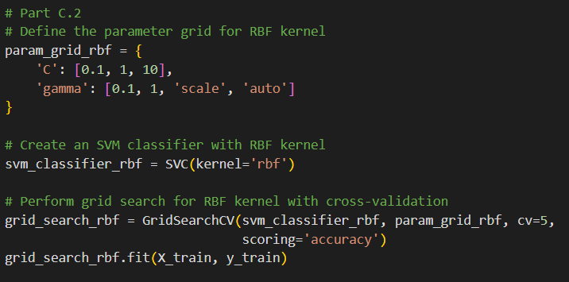
c.2 – rbf svm
Classifier Type: Support Vector Machine (SVM) with RBF Kernel.
Grid Search for Hyperparameter Tuning: Define a parameter grid (param_grid_rbf) specifying different values for 'C' (regularization parameter) and 'gamma' (kernel coefficient).
Model Initialization: Create an SVM classifier with an RBF kernel (svm_classifier_rbf).
Grid Search Execution:
Perform a grid search with cross-validation (GridSearchCV) on the RBF kernel SVM using the defined parameter grid.
Evaluate performance using 5-fold cross-validation and the accuracy scoring metric.

Slide 21
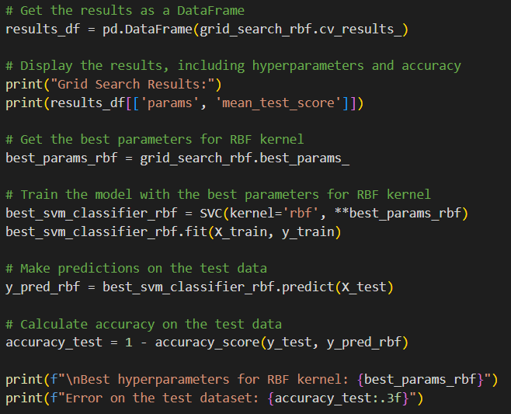
c.2 – rbf svm
Results Compilation: Retrieve the results of the grid search and organize them into a DataFrame (results_df). Display the grid search results, including hyperparameters and corresponding mean test scores.
Training with Best Parameters: Train a new SVM classifier with the RBF kernel using the best hyperparameters (best_svm_classifier_rbf).
Predictions: Utilize the trained SVM classifier to make predictions on the test set (X_test).
Error Calculation: Calculate the mean error by comparing the predicted labels (y_pred_rbf) with the true labels (y_test). The accuracy score is employed as the error metric.
Result Display: Display the best hyperparameters for the RBF kernel. Print the error on the test dataset, providing a quantitative measure of the model's predictive accuracy.

Slide 22
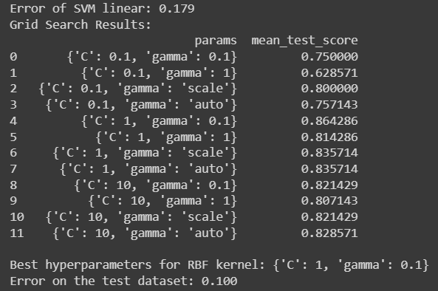
c.2 – rbf svm results
As 'C' decreases:
Grid Search Scores: The mean test scores generally decrease, indicating that lower values of 'C' result in less regularization and potentially overfitting.
Best Hyperparameter Selection: The grid search selects {'C': 1} as the best-performing 'C' value, striking a balance between regularization and capturing complex patterns.
As 'gamma' decreases:
Grid Search Scores: The mean test scores generally decrease, suggesting that lower values of 'gamma' result in a smoother decision boundary.
Best Hyperparameter Selection: The grid search selects {'gamma': 0.1} as the best-performing 'gamma' value, indicating a preference for a smoother decision boundary.

Slide 23
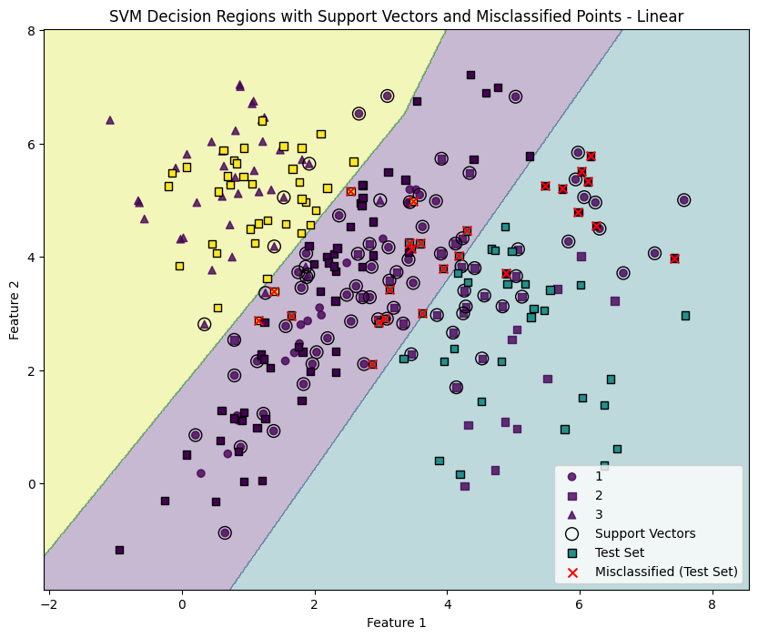
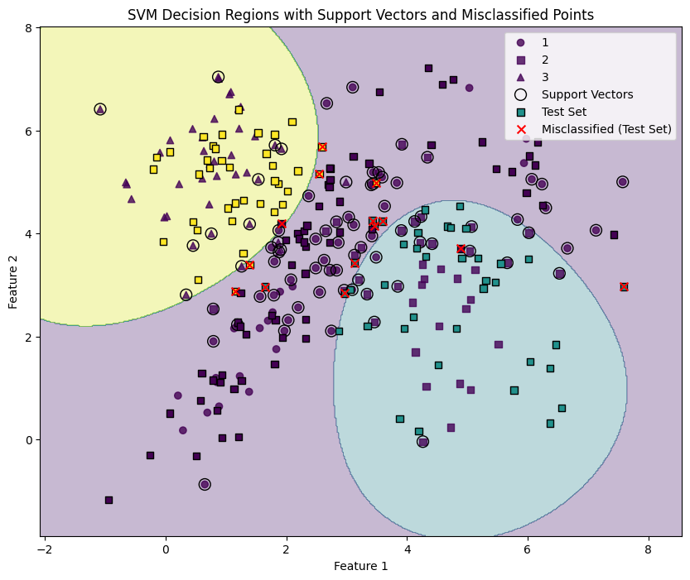
c.3 – rbf svm visualizing results

Slide 24
C. conclusion
The model achieving the lowest error, with a value of 0.093, corresponds to K-Nearest Neighbors (KNN) with k=5, whereas the second lowest error is recorded by the SVM with an RBF kernel, yielding a value of 0.100.
The SVM with RBF kernel's ability to model complex, non-linear relationships, optimal hyperparameter tuning, robustness to noise, and consideration of global decision boundaries contribute to its superior performance compared to KNN with k=5 in this specific scenario.

Slide 25
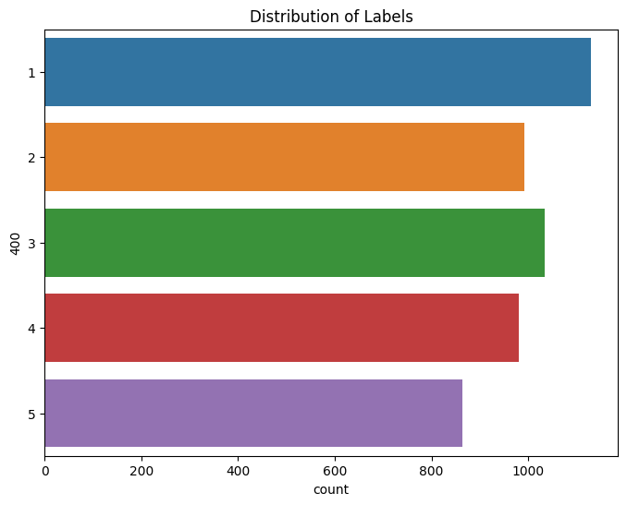
D. data Overview
The dataset is loaded from datasetC.csv file.
There are 5000 samples.
Each sample has a 400D vector (features) along with a label (1, 2, 3, 4 or 5).
The dataset loaded from datasetTestC.csv file will be used as input for the final predictions.
The datasetC is splitted into train, validation and test datasets
The datasetC is balanced and there are no missing values.
Given that the classes are balanced, metrics like accuracy, precision, recall, and F1 score should be informative. The accuracy metric will be used.

Slide 26
d.1 NAIVE BAYES CLASSIFIER
The Naive Bayes classifier is a probabilistic machine learning model based on Bayes' theorem.
It assumes that the features are conditionally independent given the class label, which is a simplifying but powerful assumption.
Naive Bayes is effective in many real-world applications, particularly in text classification and spam filtering.
It's computationally efficient, easy to implement, and requires relatively small amounts of training data.
While the "naive" assumption might not hold in all cases, Naive Bayes can still perform surprisingly well, especially when dealing with high-dimensional data or situations where the assumption of independence is reasonable.
Mean_test_score
0.794

Slide 27
d.2 logistic regression
Logistic Regression is a statistical method used for binary and multiclass classification problems.
Despite its name, it is a classification algorithm rather than a regression algorithm.
Logistic Regression models the probability that a given instance belongs to a particular class.
It employs the logistic function (sigmoid function) to transform a linear combination of features into values between 0 and 1, representing probabilities.

Slide 28
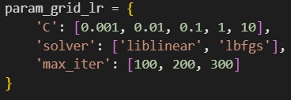
d.2 logistic regression - Hyperparameter Tuning
C: Inverse of regularization strength; smaller values specify stronger regularization, helping prevent overfitting. Increase 'C' for less regularization (allowing the model to fit the training data more closely), decrease for stronger regularization (to generalize better to unseen data).
solver : Optimization algorithm to use in the optimization problem; 'liblinear' is suitable for small datasets or when dealing with binary classification, while 'lbfgs' is efficient for large datasets and multiclass problems.
max_iter: Maximum number of iterations for the solver to converge; increase if convergence is not reached within the default number of iterations.
c | solver | Max_iter | Mean_test_score
0.01 | lbfgs | 100 | 0.818286
0.01 | lbfgs | 200 | 0.818286
… | … | … | …
10 | lbfgs | 100 | 0.722571

Slide 29
d.3 K-NEAREST NEIGHBORS (KNN) CLASSIFIER
K-Nearest Neighbors (KNN) is a simple and intuitive classification algorithm that operates based on the idea of proximity, assigning labels to data points by considering the majority class among their k nearest neighbors.
KNN relies on distance metrics, commonly using Euclidean distance, to measure the similarity between data points. The choice of distance metric is crucial and depends on the nature of the data.
Number of Neighbors (k): The hyperparameter 'k' determines the number of neighbors considered during classification. A smaller 'k' may lead to more flexible decision boundaries, but it can also make the model sensitive to noise.

Slide 30
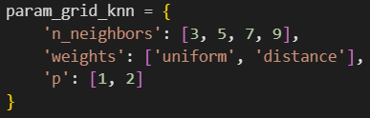
d.3 Knn - Hyperparameter Tuning
n_neighbors: Increasing: Smoother decision boundary, less sensitivity to local noise. Decreasing: More sensitivity to local variations, potential overfitting.
Weights:
'uniform': Treats all neighbors equally, uniform voting.
'distance': Gives more weight to closer neighbors, emphasizing local patterns.
P:
'p=1' (Manhattan): Angular decision boundary, considers absolute differences.
'p=2' (Euclidean): Smoother boundary, straight-line distance.
n_neighbors | weights | p | mean_test_score
9 | Distance | 2 | 0.741714
7 | Distance | 2 | 0.734571
… | … | … | …
3 | Uniform | 1 | 0.643143
Best score in extended search

Slide 31
D.4 SUPPORT VECTOR MACHINE
Support Vector Machines (SVM) are powerful supervised learning algorithms designed for classification and regression tasks.
SVMs excel in high-dimensional datasets and are particularly effective when dealing with complex decision boundaries.
As an ensemble method, SVMs make predictions by finding the optimal hyperplane that maximizes the margin between different classes.
SVMs can handle both linear and non-linear relationships through the use of various kernel functions.
One key strength of SVMs lies in their ability to generalize well to new, unseen data, making them suitable for diverse applications in machine learning.

Slide 32
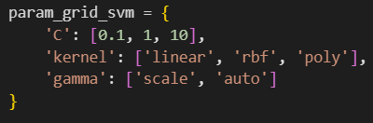
D.4 SVM - Hyperparameter Tuning
C: the penalty parameter, which represents misclassification or error term. The misclassification or error term tells the SVM optimization how much error is bearable. This is how you can control the trade-off between decision boundary and misclassification term. when C is high it will classify all the data points correctly, also there is a chance to overfit.
kernel: The main function of the kernel is to take low dimensional input space and transform it into a higher-dimensional space. It is mostly useful in non-linear separation problem.
gamma: It defines how far influences the calculation of plausible line of separation. when gamma is higher, nearby points will have high influence; low gamma means far away points also be considered to get the decision boundary.
C | Kernel | Gamma | mean_test_score
1 | scale | rbf | 0.841143
10 | scale | rbf | 0.840286
10 | auto | rbf | 0.838857
1 | auto | rbf | 0.8388571
… | … | … | …
0.1 | scale | poly | 0.229429
0.1 | auto | poly | 0.227429

Slide 33
d.5 MULTIPLAYER PERCEPTRON (MLP) CLASSIFIER
Multilayer Perceptron (MLP) Classifier is a versatile neural network algorithm used for both classification and regression tasks.
It is a type of feedforward artificial neural network with an input layer, one or more hidden layers, and an output layer.
MLPs can learn complex relationships in data, making them suitable for tasks with intricate patterns.
They use backpropagation for training, adjusting weights to minimize the difference between predicted and actual values.
While MLPs can model non-linear relationships effectively, they may require careful tuning of hyperparameters to prevent overfitting and achieve optimal performance.

Slide 34
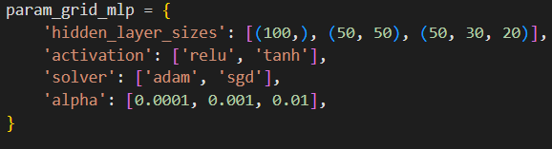
d.5 mlp - Hyperparameter Tuning
hidden_layer_sizes: Configures the neural network architecture by specifying the size of hidden layers, influencing the model's capacity to learn intricate patterns.
activation: Determines the activation function for hidden layers, introducing non-linearities crucial for capturing complex relationships in the data.
solver: Chooses the optimization algorithm (e.g., 'adam', 'sgd') for weight updates during training, impacting the efficiency and effectiveness of the learning process.
alpha: Controls overfitting through L2 regularization, penalizing large weights and ensuring a balance between fitting the data and preventing excessive complexity.
hidden_layer_sizes | activation | solver | alpha | mean_test_score
(100,) | relu | adam | 0.01 | 0.8120
(100,) | relu | adam | 0.0001 | 0.8102
… | … | … | … | …
(50, 30, 20) | tanh | sgd | 0.001 | 0.7683

Slide 35
D.6 Random forest classifier
Random forests are for supervised machine learning, where there is a labeled target variable.
Random forests can be used for solving regression (numeric target variable) and classification (categorical target variable) problems.
Random forests are an ensemble method, meaning they combine predictions from other models.
Each of the smaller models in the random forest ensemble is a decision tree.

Slide 36
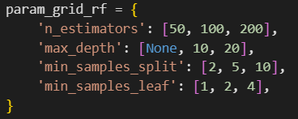
D.6 Random forest - Hyperparameter Tuning
n_estimators: the number of decision trees in the forest. Increasing this hyperparameter generally improves the performance of the model but also increases the computational cost of training and predicting.
max_depth: the maximum depth of each decision tree in the forest. Setting a higher value for max_depth can lead to overfitting while setting it too low can lead to underfitting.
min_samples_split: determines the minimum
number of decision tree observations in any
given node in order to split.
min_samples_leaf: specifies the minimum
amount of samples that a node must hold after
getting split. It also helps to reduce overfitting
when we have ample amount of parameters.
Max_depth | Min_samples_leaf | Min_samples_Split | N_estimators | Mean_test_score
20 | 1 | 10 | 200 | 0.732000
20 | 4 | 10 | 200 | 0.730000
… | … | … | … | …
20 | 1 | 2 | 50 | 0.624571
Best score in extended search

Slide 37
d.7 XGBoost
XGBoost is a supervised machine learning algorithm suitable for both regression and classification tasks.
As an ensemble method, it combines predictions from multiple decision trees to create a robust and accurate model. Each individual model within the XGBoost ensemble is a decision tree.
The algorithm employs gradient boosting to build trees sequentially, correcting errors from previous iterations.
Notable features of XGBoost include regularization for controlling model complexity and effective handling of missing values during training.
Unlike some other classifiers, XGBoost assumes that the class labels should be integers starting from 0.

Slide 38
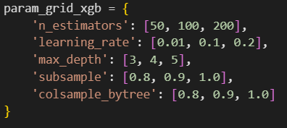
d.7 XGBoost - Hyperparameter Tuning
n_estimators: It determines the total number of trees in the ensemble.
learning_rate: It scales the contribution of each tree. A lower learning rate requires more boosting rounds but can lead to a more robust model.
max_depth: It controls the maximum depth of each tree in the ensemble. Deeper trees can capture more complex patterns but may lead to overfitting.
subsample: It determines the fraction of training data to be used in each boosting round. A value less than 1.0 introduces randomness and helps prevent overfitting.
colsample_bytree: It controls the fraction of features (columns) to be used in each boosting round. It introduces randomness to prevent overfitting and improve generalization.
n_estimators | learning_rate | max_depth | subsample | colsample_bytree | mean_test_score
200 | 0.2 | 3 | 0.8 | 0.9 | 0.79028
200 | 0.2 | 3 | 0.8 | 0.8 | 0.78828
200 | 0.2 | 3 | 0.8 | 1.0 | 0.78400
… | … | … | … | … | …

Slide 39
D.8 VOTING CLASSIFIER
Ensemble methods, such as the Voting Classifier, combine multiple individual models to improve overall predictive performance.
The Voting Classifier aggregates the predictions of diverse base models, such as Decision Trees, Support Vector Machines, or Logistic Regression, and produces a final prediction based on a majority vote or weighted combination.
This approach enhances robustness, generalization, and mitigates the risk of overfitting, making it particularly effective in scenarios where individual models may have limitations.
Ensemble methods are widely employed in machine learning for achieving higher accuracy and stability across a variety of applications.
In ensemble models, it's beneficial to include diverse base models that have different strengths and weaknesses.

Slide 40
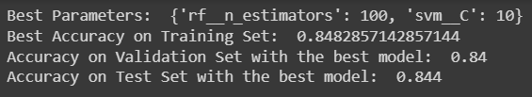
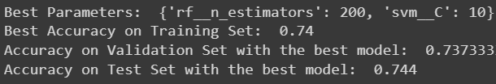
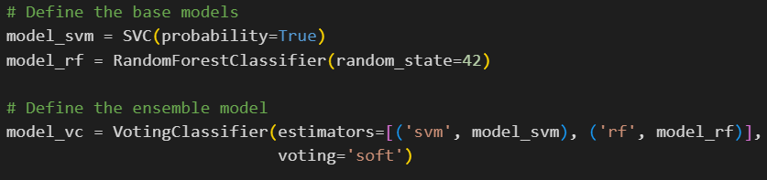
d.8 VOTING CLASSIFIER
Soft Voting: The final prediction is based on the average probability across all base models. Soft voting is often preferred when base models can provide probability estimates, as it takes into account the confidence of each model's predictions.
Hard voting: The final prediction is based on the majority vote of the base models.

Slide 41
d.9 stacking
Stacking is an ensemble learning technique that involves combining the predictions of multiple base models to create a more powerful and accurate meta-model.
This approach leverages the diverse strengths of individual models, mitigating their weaknesses and enhancing overall predictive performance.
Stacking is particularly effective when different models excel in capturing distinct patterns or nuances within the data, providing a comprehensive and robust solution to complex prediction tasks.
The process typically consists of two stages: in the first stage, various base models are trained independently on the training data; in the second stage, a meta-model is trained to make predictions based on the outputs of the base models.

Slide 42
d.10 bagged decision trees
Bagged Decision Trees, an ensemble technique, involve training multiple instances of a base Decision Tree model on different bootstrap samples of the training data.
By aggregating the predictions of individual trees through voting, Bagged Decision Trees enhance model robustness and generalization, reducing the risk of overfitting.
BDT, or Bootstrap Aggregating of Decision Trees, is primarily employed to reduce overfitting and enhance the robustness of decision tree models.
The main parameter to consider is the number of base decision trees (n_estimators), which controls the diversity and strength of the ensemble.
This technique is particularly beneficial when dealing with high-variance models, and its effectiveness becomes pronounced in scenarios where individual decision trees are prone to overfitting.

Slide 43
Classifiers |  |  |  |  |  | Mean_error
Voting (Soft): | SVC | RandomForestClassifier | - | - |  | 0.848
Voting (Soft): | SVC | - | MLPClassifier | - |  | 0.833
Voting (Soft): | SVC | RandomForestClassifier | MLPClassifier | - |  | 0.825
Voting (Hard): | SVC | RandomForestClassifier | MLPClassifier | XGBClassifier |  | 0.824
Voting (Soft): | SVC | RandomForestClassifier | MLPClassifier | XGBClassifier |  | 0.848
Voting (Soft): | SVC | RandomForestClassifier | - | XGBClassifier |  | 0.853
Voting (Soft): | SVC | - | - | XGBClassifier |  | 0.848
Stacking | OneVsRest | RandomForestClassifier | MLPClassifier | Logistic Regression (Final) |  | 0.849
Bagged Decision Trees | DecisionTreeClassifier |  |  |  |  | 0.688
Stacking | SVC | RandomForestClassifier | KNN |  | RandomForestClassifier (Final) | 0.858
AdaBoostClassifier | DecisionTreeClassifier |  |  |  |  | 0.356

Slide 44
Thanks for your time!!

